Slide 1
Part B Webinar Series Presentation:
Choosing an Improvement Project – Part 2
Tue, Sep 14 at 10am ET (1 hour)

Slide 2

Introductions
Please share your name, agency, and one expectation for this training in the chat

Slide 3
Reminder about Basic Zoom Functions
Notes:
Here are several functions of Zoom, the chat box can be found in the bottom center of your screen as shown here. And the mute button can be found in the bottom left corner of your screen.

Slide 4


Good Practices for Zoom Participation
Re-label your Zoom tile to state your name
Keep video on and mute your line when needed
Use the chat room to ask for clarifications, post questions, or share your wisdom
Please be reminded that we will record our session for later replay!
Notes:
Keep the following best practices in mind for todays webinar:

Slide 5
Picture Consent
You allow us to take pictures from our training events and post them on SharePoint
You have the right to revoke your consent for pictures that are publicly posted
At no time will individual names be used to identify you, unless you sign the
appropriate release form
Notes:
Please note that CQII will take screenshots from our Zoom sessions and you allow us to use them on our websites and social media postings.
You individual names will NOT be used to identify you, unless you sign the appropriate release form.

Slide 6
Learning Objectives
Today, we will give you a better understanding of:
The steps in the PDSA Cycle
How you learn from theory and prediction
How to start a PDSA Cycle
The importance of a plan with clear objectives and staff roles and commitments
How your data help you tweak and improve your plan

Slide 7
PDSA Cycle

Slide 8
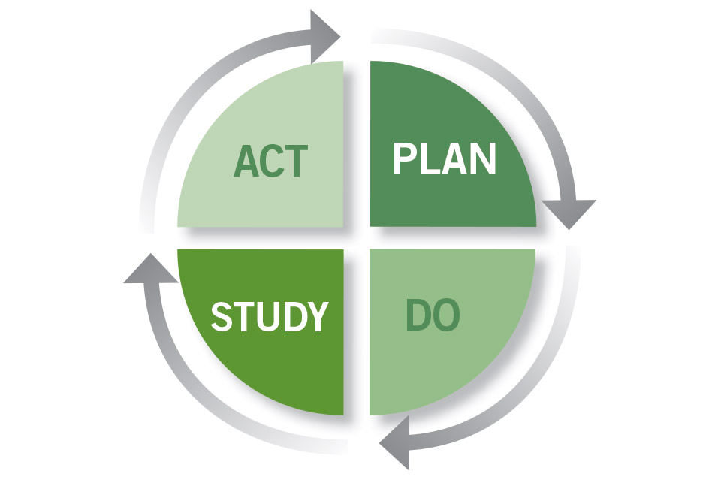
Introducing the PDSA Cycle
AKA The Deming Wheel
The PDSA Cycle, designed to test a change, was first introduced to W. Edwards Deming by his mentor, Walter Shewhart of Bell Laboratories in New York.
Deming amended the Shewhart Cycle and replaced Check with Study. He felt it made individuals look more deeply at their data.

Slide 9
Why Do We Use PDSA Methodology?
Why Do We Need To Test Change?
To increase your belief that a change will result in an improvement
To evaluate how much improvement can be expected from the change
To decide if the change will work in your environment
To evaluate cost, benefits, impact, and unintended consequences
Lessen stakeholder resistance by starting small and proving the concept

Slide 10
Understanding the PDSA Cycles
The PDSA Cycles start with small tests and ramps up to bigger tests
After each test, see if your result matches your hypothesis
Implement another test based on the results of the prior test
  If successful, increase the number of clients or days or providers, or whatever is needed to expand the scope of the test
  If not successful, tweak your test and try again with a small sample
  Don’t be afraid to abandon the idea if continuous testing doesn’t match the hypothesis
Each test of the change helps to improve your ability to reach your goal by adjusting the intervention according to what you learned

Slide 11
Step 1: PLAN
State the objective of the test
Choose the team and clarify roles: Who will do what, when, why and where?
Your hypothesis makes a prediction about what will happen (ours was: If we lower the no-show rates, then our viral suppression will increase)
Determine your first test population – start small
Document each test – leave an audit trail for this project and a teaching aid for future projects

Slide 12
PLAN Cycle Example
Decreasing the “No Show” Rate
Our Data Analysis, Root Cause Analysis, Brainstorming, and Force Field Analysis have led us to the hypothesis that implementing an Uber contract for client transportation will decrease the “No Show” rate from the current 30% to 10%
  Hypothesis: If we do this, then this will happen
  We have brought more specificity to our hypothesis

Slide 13
PLAN Cycle Example
Decreasing the “No Show” Rate
The plan for the first cycle is:
  One Case Manger will arrange the transportation for clients with the highest “No-show” rates
  The number of missed appointments will be documented
  The client’s satisfaction with the service will be documented
  The first cycle will include one client with an appointment on one day, who has already missed 2 appointments in a row due to lack of transportation
  We choose one client to start
  The receptionist will collect the data

Slide 14
Let’s Examine The Plan and Review
You analyzed data
You set step measures:
  The number of missed appointments will be documented
  The client’s satisfaction with the service will be documented
You started small (one client, one day)
You have the infrastructure in place

Slide 15
Step 2: DO
Carry out your plan
Collect data on your step measures
  Make sure the data are directly related the hypothesis
  Use a standardized data collection tool
    Check sheet
    Excel
Document
  Documenting steps as a permanent record of your activities
  It acts as a road map for future tests
  It’s a training tool for staff now and in the future; turn over negatively affects quality
Note anything unexpected that happened

Slide 16
DO Example
Case Manager arranges the Uber pick up for the one client
Receptionist notes that the client did not miss the appointment
Client satisfaction with service was logged
No barriers were noted, nothing unexpected happened
The check sheet may look like this:
Client Id | Client presented | Client saw prescriber | Pt satisfaction rating 1 = Bad/5 = good | Comments
12345 | Yes or no | Yes or no | 4

Slide 17
Step 3: STUDY
Analyze the data collected by your step measures
Compare your data to your hypothesis
  Did the test work as predicted?
  Did the data match or come close to the hypothesis?
Summarize and reflect on what you learned

Slide 18
Step 3: STUDY Example
The cycle was implemented with one client and the plan worked as predicted
The step measures showed:
    The client indicates satisfaction with the service
    The client made the appointment
Feedback from the Case Manager and receptionist indicate to expand the scope of the test as is

Slide 19
Study Cycle Summary
We analyzed the data
We see that we achieved the result we thought we would
We received input from the team
We then proceed to the Act Cycle

Slide 20
Step 4: ACT
Your action should depend on what you learned
  Should you expand the scope of the test for the next cycle?
  Do you need to modify the intervention and retest a small sample?
  After a few tests, decide if:
      You should abandon if no test seems to support the hypothesis
      Rethink the hypothesis if inconclusive
Share your results and get feedback and input from your QI team

Slide 21
Step 4: ACT Example
The results of the first test are shared with the team
The team decides to expand the test to 3 other clients who are chronic no-shows
Enter the Plan phase for Cycle 2

Slide 22
Act Cycle Summary
This is where you apply your analysis and observation
If you are satisfied with the result, you expand the test
If you are not satisfied with the result, you may consider tweaking it
In this phase, you conceptualize the next test
  How many clients involved
  The staff member(s) involved in testing
Move on to the next cycle

Slide 23
Plan Cycle 2: Three Clients
PDSA Cycle Step | Action
Plan | Expand test to 3 additional clients
Do | Case Manager contacts 3 clients with upcoming appointments and arranges their Uber transportation
Study | > Receptionist documents that 2 clients arrived and departed as planned > One client was not available for pick up > Follow up indicates that 2 clients were satisfied with the service and 1 client was waiting for pick up at a different address > Case Manager notes that the agency had to pay for all 3 rides
Act | > Case manager adds an updated address check before arranging rides, to her To Do list > Case manager advises a small increase in test scope

Slide 24
Cycle 3: Five Clients
PDSA Cycle Step | Action
Plan | Case Manager confirms current addresses and arranges Uber rides for 5 clients with appointments in the first 2 weeks of May
Do | Four clients arrive on time and 3 arrived at home at the prescribed time. One client cancels appointment the day of appointment
Study | > Three clients express satisfaction, 1 client expresses frustration with Uber delay going home. Driver got caught in the Cinco De Mayo parade traffic > Receptionist did not make Case Manager aware of the cancellation, so agency had to pay for that ride
Act | > Test not matching the hypothesis > Case manager calls a team meeting before entering next cycle

Slide 25
Time for a Team Meeting
Case Manager expresses frustration at the amount of work involved
    Requests that clients be able to schedule their own rides
    Due to possibility of abusing Uber Health rides and charges, the team denies the request
Receptionist offers to schedule rides; since she already handles the cancelations, she will be the point person for ride schedules
Receptionist will add the Uber information when the standard client appointment reminders go out
Receptionist will coordinate with Case Manager, and Case Manager will continue to document success and failure of rides as well as client satisfaction

Slide 26
Cycle 4: Repeat with 5 New Clients
PDSA Cycle Step | Action
Plan | > The team plans to pick 5 new clients > Receptionists schedules 5 rides for clients for the following Monday
Do | > Reminders that include the Uber Health info are communicated to the client two days prior to appointment > Pick up addresses are confirmed by receptionist
Study | > Four clients arrive and depart on time, one client cancels appointment > Four clients express satisfaction with the service > Fifth client pick was able to be cancelled, so no charges to the agency for that client
Act | Expand test to all clients who are chronic no-shows for the following week who need transportation

Slide 27
Summary
Small tests are necessary to test the idea
  If the idea works in a small test expand the test
  If the idea isn’t supporting the hypothesis; decide to review the data and test a new idea, tweak the current idea or abandon your hypothesis
If an idea is fully implemented without testing, the results could harm the operation of an organization
  Imagine the confusion if there were dozens of chronic no-show clients getting Uber Health rides
  Imagine the task of tracking all these clients
In our model project, we saw:
  Inconsistent early results
  Frustration by the case manager
  Changes to our test
      Receptionist takes on more coordination responsibilities
      Communication was approved; cancelled appointment coordination improved

Slide 28
Summary
We made adjustments as necessary
Our repeated tests gave us increase confidence in our change idea
The quality improvement project team worked together to analyze the data and keep the focus on the project
PDSA Cycles are iterative; never claim success or failure after one test

Slide 29
Aha Moments and Wrap Up

Slide 30
Notes:
How helpful was today’s session to learn about quality improvement?
[1-not at all helpful, 2-not so helpful, 3-somewhat helpful, 4-very helpful, 5-extremely helpful]

Slide 31
Notes:
How engaged were you in today’s session?
[not at all engaged, 2-rarely engaged, 3-somewhat engaged, 4-engaged, 5-extremely engaged]

Slide 32
Notes:
How likely will you implement the lessons learned of this session when working with your programs?
[1-very unlikely, 2-somewhat unlikely, 3-neither likely nor unlikely, 4-somewhat likely, 5-very likely]

Slide 33
QI Training Modalities
Training | Purpose | Frequency | Description
QI Webinar Series | Introducing Part B-funded providers to “QI 101” and providing them with real-world application of QI initiatives. | 6x a year | Six (6) webinar sessions - sixty (60) minutes each for Part B-funded service providers in need of QI training.
QI Bootcamp for Part B Providers | Building their QI capacity to apply the QI learning content within their programs. | 3x a year | Six (6) sessions - ninety (90) minutes each, using a case study learning approach to apply QI/QM in a Part B provider setting.
QI Sharing Sessions | Providing QI content presentations during QI Sharing Sessions. | 4x a year during each of the 3x groups per year | 15-20 min presentations on key QI topics by a QI content expert.
Technical Assistance and Coaching by Contract Managers | Providing assistance and guidance to reach all QI milestones. | Continuously available with monthly provision anticipated based on experience | Technical assistance and coaching during contract monitoring and quality management assessments.
Office Hours | Providing individualized technical assistance. | 12x a year | Twelve (12) sessions to assist with answering any QI questions.
AIRS Training | Ongoing AIRS trainings | Monthly on a variety of topics | Learning how to report performance data.
Access to CQII Training Materials | Providing an ongoing QI resource to learn more about QI. | Continuously available | Sharing of QI training resources, such as Quality Academy tutorials.

Slide 34
Resources
PDSA Cycles
    https://www.youtube.com/watch?v=gEbV1yg0LwU
PDSA Cycle worksheet
    https://targethiv.org/library/mfipdsa-worksheet
Foundation and History of the PDSA Cycle
    https://deming.org/uploads/paper/PDSA_History_Ron_Moen.pdf

Slide 35


Slide 36
Contact Information
Kevin Garrett, MSW
Senior Manager, CQII
New York State Department of Health
AIDS Institute
90 Church Street, 13th floor
New York, NY 10007-2919
Kevin.Garrett@health.ny.gov

